Slide 1
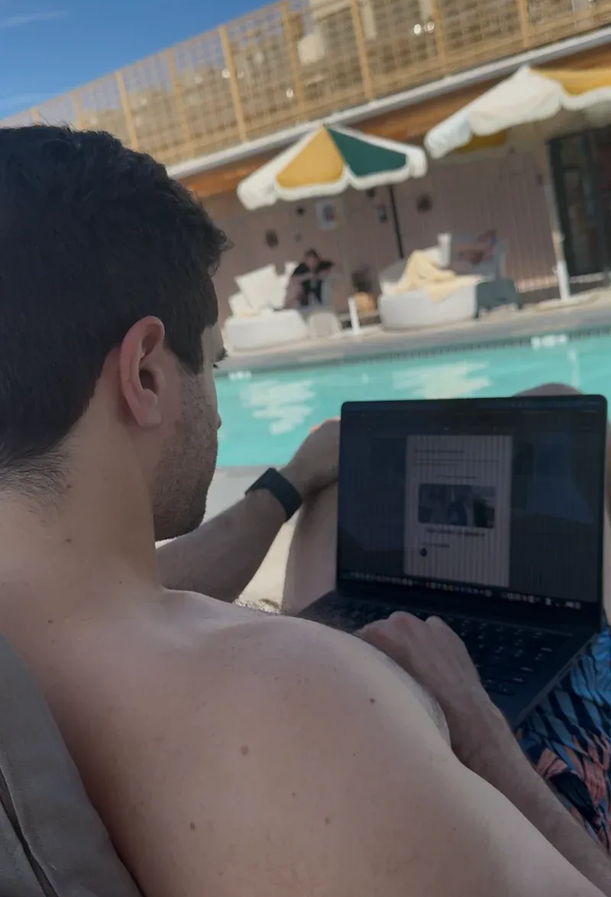
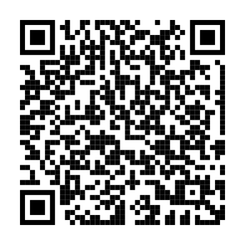
Launch day!!!
Launch day!!!
Scan to listen
Scan to listen
Launch day!!!
Launch day!!!
Scan to listen
Scan to listen
Launch day!!!
Launch day!!!
Scan to listen
Scan to listen
Launch day!!!
Launch day!!!
Scan to listen
Scan to listen
Notes:
Original page size: 8.5 × 11 inches. After import, check the page dimensions, fonts, line breaks and photo crops before printing. Text boxes and individual graphics can be moved or edited. Fonts are named, not embedded. Keep QR graphics square and scan the final exported file. Editing this file does not update its source.

