Slide 1
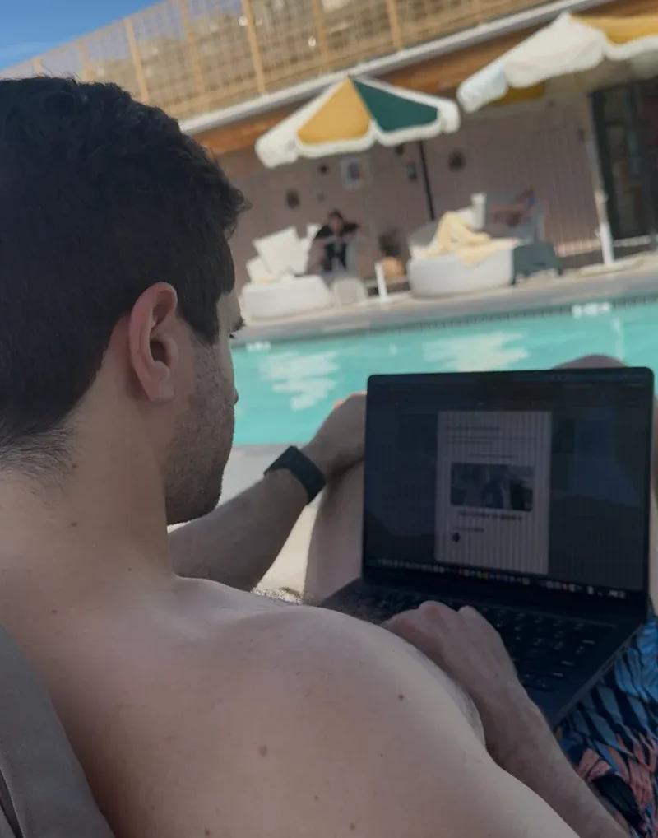
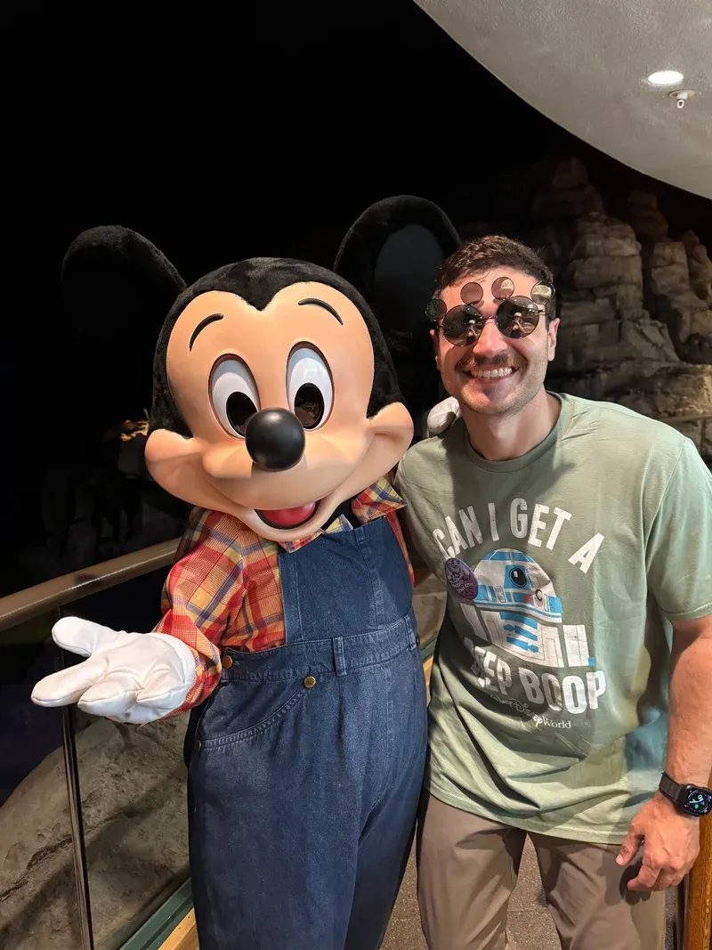

Launch day!!!
Vacation, but still
grinding
A reminder to myself to
always have fun.
Life is about the little things and
the little moments
September 27, 2026
Scan to listen
Notes:
Original page size: 4 × 6 inches. After import, check the page dimensions, fonts, line breaks and photo crops before printing. Text boxes and individual graphics can be moved or edited. Fonts are named, not embedded. Keep QR graphics square and scan the final exported file. Editing this file does not update its source.

